Slide 1
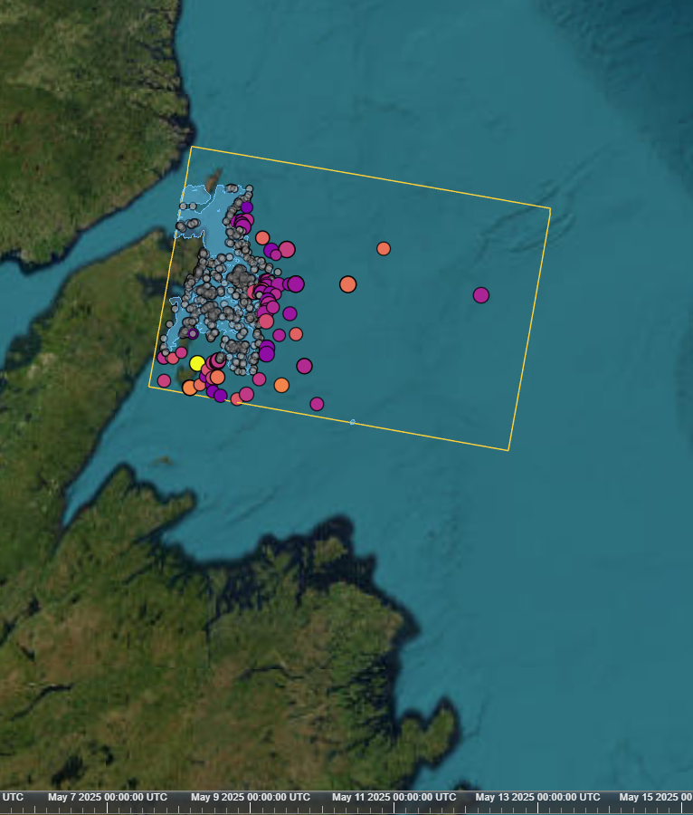
CA-CFAR vs. THOR
BRIEF · ICEBERG DETECTION
A classical radar detector and a SAR foundation model, tested on the same scenes against the same Ice Patrol labels.
Natali Kovalski · October 2026
Notes:
Part of the Iceberg Alley SAR project. The question: does a frozen foundation model with a tiny trained head find more icebergs in Sentinel-1 imagery than a well-tuned classical CFAR detector, under identical conditions?

Slide 2
Two ways to find a bright berg
THE CONTENDERS
CA-CFAR
THOR + linear head
No training: each pixel vs. its local background, on HV
Threshold from a false-alarm rate and the scene's speckle
Filters: size, ice strips up to 300 m, HH co-pol check
CPU: a full 8-PFA sweep takes about 6 min per scene
Frozen encoder: THOR Tiny (FM4CS), pretrained on Sentinel-1
769-parameter head trained on IIP labels, 2019–2020
Input: HH/HV sigma0 in dB, 80 m patches
GPU: 8–15 min per scene on a laptop RTX 3070
CA-CFAR vs. THOR · Brief
2
Notes:
CA-CFAR = cell-averaging constant false alarm rate: the background is the mean of a ring around each pixel, and the threshold follows from a chosen false-alarm probability under a gamma speckle model. THOR is a remote-sensing foundation model; here its encoder stays frozen and only a linear layer on four of its blocks (4 x 192 features + bias = 769 parameters) is trained, to output an iceberg heatmap. Reference: Forgaard et al., IGARSS 2026.

Slide 3
Everything identical except the detector
TEST SETUP
Same frames
Same masks
Four April 2019 passes with same-pass IIP analyst labels: 512 bergs. None was used in training.
Land + 500 m, pack ice + 1 km. Detections within 5 km of pack ice are dropped for both.
Same matching
Same budget
One-to-one within 500 m, with IIP positions moved to their 0.1′ cell centres.
Precision needs AIS, so recall is compared at a matched number of detections per frame.
CA-CFAR vs. THOR · Brief
3
Notes:
Nothing was tuned on these frames: the models were fixed on 2019/2020 year folds, and the PFA list, bins and radii were in config.yaml before the first run. The CFAR is swept over PFA 1e-3 to 1e-12; THOR over its score. Three of the four frames were added after the first run to check that 04-29 wasn't a lucky frame; HyP3 refused the richest open-ocean frames (no DEM coverage).

Slide 4
HEADLINE RESULT
+10 pts
THOR finds 84% of the labelled bergs where the CA-CFAR finds 74%, at the same number of detections: 431 vs. 380 of 512.
4 held-out frames · 926 open-water detections each · THOR leads on every frame
CA-CFAR vs. THOR · Brief
4
Notes:
Pooled over the four frames, at the CFAR's detection count at PFA 1e-6. Overlap: 356 bergs found by both, 75 by THOR only, 24 by the CFAR only, 57 by neither (38 of those within 5 km of pack ice, where both detectors are filtered out). The pooled gap is about five times the binomial sampling noise (+/- 0.02 at n = 512).

Slide 5
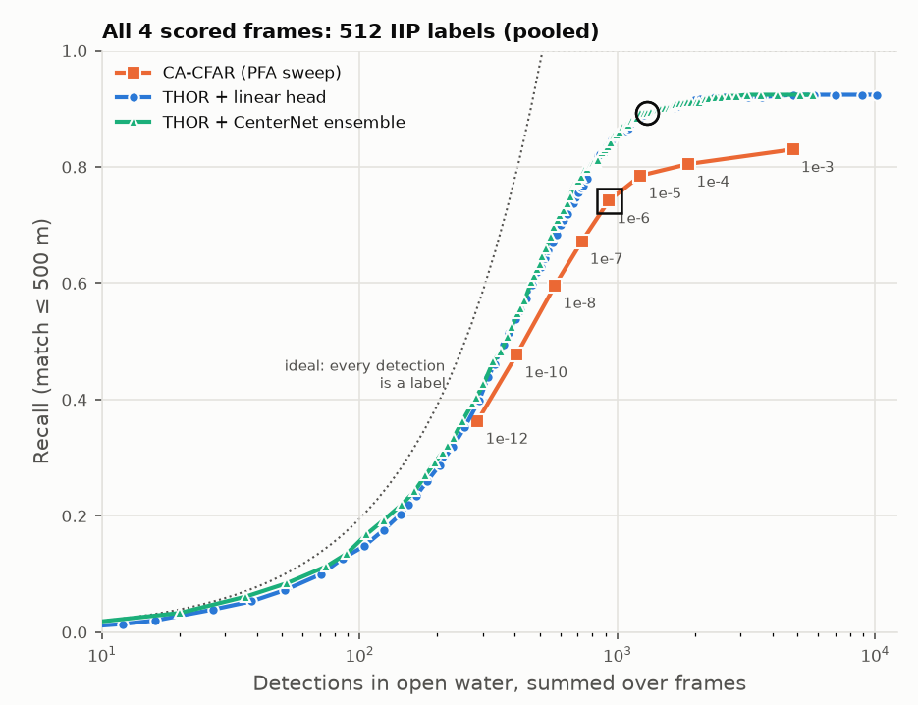
THOR climbs, CFAR saturates
RECALL VS. DETECTIONS
Same recall as the CFAR with ~28% fewer detections
CFAR at its loosest (PFA 10⁻³): 0.83 with 4,798 detections
THOR reaches that with ~900, and tops out at 0.92
Its top ~100 peaks are almost all labelled bergs
Pooled, 512 IIP labels. Square: CFAR at PFA 10⁻⁶. Circle: THOR at score 0.35.
CA-CFAR vs. THOR · Brief
5
Notes:
Each point is an operating point: detections in open water (x, log scale) against the share of labelled bergs matched (y). The dotted line is the ideal where every detection is a labelled berg. Loosening the CFAR from 1e-5 to 1e-3 adds about 3,500 detections for a few more bergs. Linear and CenterNet heads are indistinguishable, so the 769-parameter linear head is the one to keep.

Slide 6
Ahead on every frame, by 0 to 15 points
PER FRAME
Frame | IIP labels | Detections | CA-CFAR | THOR
2019-04-29 | 267 | 476 | 0.74 | 0.89
2019-04-23 | 150 | 278 | 0.79 | 0.82
2019-04-24 | 49 | 44 | 0.76 | 0.82
2019-04-17 | 46 | 128 | 0.61 | 0.67
Pooled | 512 | 926 | 0.74 | 0.84
04-17 is low for both: 7 of its 46 bergs lie within 5 km of pack ice, where both detectors are filtered out. The first frame, 04-29, overstated the gap.
CA-CFAR vs. THOR · Brief
6
Notes:
Recall at the same number of open-water detections per frame (the CFAR's count at PFA 1e-6). The frames are 1 to 12 days apart, so some bergs appear on more than one, at different positions; each is still a separate image with its own sea state and ice.

Slide 7
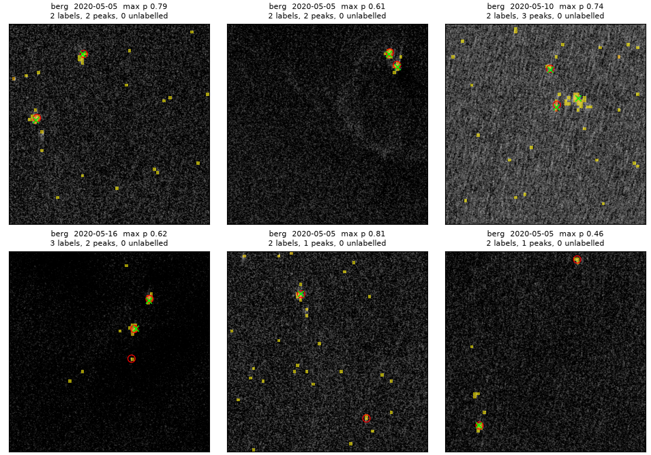
Large and medium bergs, not small ones
WHERE THE GAIN IS
Bergs (pooled) | CFAR | THOR
Small, 15–60 m (73) | 0.71 | 0.71
Medium, 61–120 m (425) | 0.76 | 0.87
Large, > 120 m (14) | 4 | 11
> 20 km from ice (275) | 0.80 | 0.93
Incidence 40–47° (398) | 0.73 | 0.83
THOR heatmaps on 2020 validation chips: IIP labels (red circles), THOR peaks (green ×). Large bergs: the CFAR sees them, then its 300 m strip rule drops them.
CA-CFAR vs. THOR · Brief
7
Notes:
Large bergs: on 04-29 all four are 30+ dB above the sea in HV, so the CFAR threshold fires at any PFA, but their grown blobs measure 340-470 m, above max_structure_m (300 m), the rule that rejects sea-ice strips. THOR has no such rule. Small bergs are near the ~20 m true resolution while a THOR token covers 80 m, which is the case for a 4x4 patch run. Matching radius doesn't drive the gap: from 200 m to 500 m both curves are flat.

Slide 8
THOR doesn't replace the pipeline
LIMITS
01
02
03
Pack ice
Small bergs
Precision
Alone, it fires on pack ice: 34–82% of its peaks on icy frames fall inside the CFAR's ice mask.
A tie at 0.71. An 80 m patch is coarse for a 20 m target; 4×4 patches are the next test.
Unknown for both without AIS. At the matched count, CFAR has 546 and THOR 495 unlabelled detections.
CA-CFAR vs. THOR · Brief
8
Notes:
On 2019-04-15, with pack ice in the scene, 47% of the linear head's peaks fall in the CFAR's masked area; on ice-free 04-24 it is 0. THOR depends on the HV pack-ice mask of the CFAR pipeline. Also: THOR learned what IIP analysts label, so part of the gap may be agreement with their labelling style, not only better detection.

Slide 9
THOR on top of the CFAR pipeline
VERDICT
What holds
Next
+10 points recall at an equal number of detections
Large bergs: 11 of 14 found, CFAR 4
Needs the pipeline: its pack-ice mask, and a GPU
Caveat: one month of one year; THOR learned the analysts' labels
AIS for the test frames to measure precision for both
Shape-based strip test so the CFAR keeps large bergs
THOR at 4×4 patches for small bergs
More years and near-range frames
CA-CFAR vs. THOR · Brief
9
Notes:
On four held-out frames with same-pass labels (512 bergs), THOR (frozen encoder + a 769-parameter linear head) finds 10 percentage points more of the analyst-labelled bergs than the CA-CFAR at the same number of detections, leads on every frame, and finds most of the large bergs that the CFAR's strip rule rejects. The gain is in medium and large bergs; small bergs are a tie. Any strip-rule fix must be tuned off the test frames.

Slide 10
Questions?
THANK YOU
Natali Kovalski · github.com/natali-kovalski/iceberg-alley-sar
Live viewer with both detectors: natali-kovalski.github.io/iceberg-alley-sar. Write-up: docs/thor-vs-cfar.md. Contains modified Copernicus Sentinel data (2019–2026). Labels: International Ice Patrol (NSIDC G00807). THOR: FM4CS (Apache 2.0); Forgaard et al., IGARSS 2026.
Notes:
The repository has the full write-up: method, validation findings and limitations, plus the viewer.

